Slide 1
Unit 3
IMAGES, COLORS AND BACKGROUND

Slide 2
HTML <body> vlink Attribute
The vlink attribute specifies the color of visited links in a document.

Slide 3
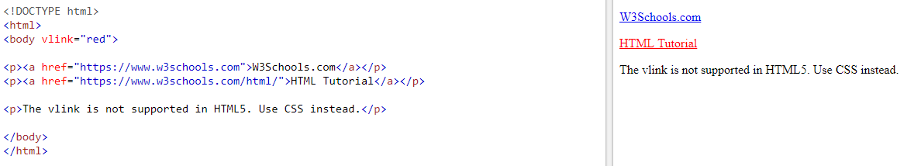

Slide 4
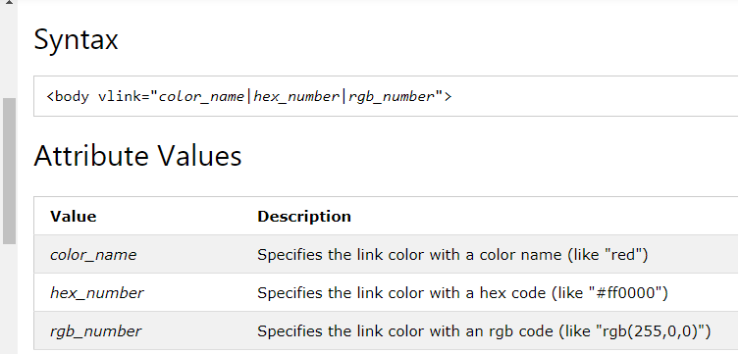
vlink syntax

Slide 5
Changing link colors with link attributes of the <body> tag
The three link color attributes of a webpage are:
link — this changes the normal link color.
In other words, this attribute changes the default blue color of the links to some other color of your choosing.
vlink — this attribute changes the visited link color.
With this attribute, you can change the default visited purple link color to some other color of your choice.
alink — This attribute changes the active link color.
An active link color simply means the displayed link color when the mouse button is pressed over a link.

Slide 6
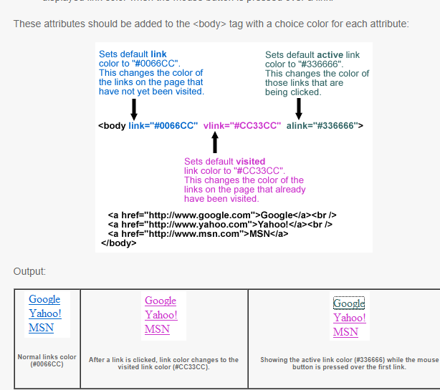

Slide 7
HTML <body> background Attribute
The background attribute specifies a background image for a document.

Slide 8
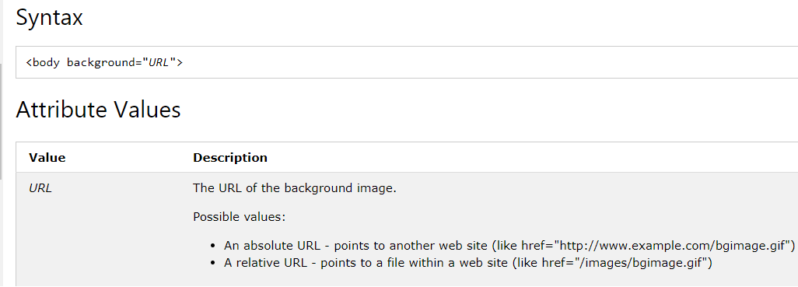

Slide 9
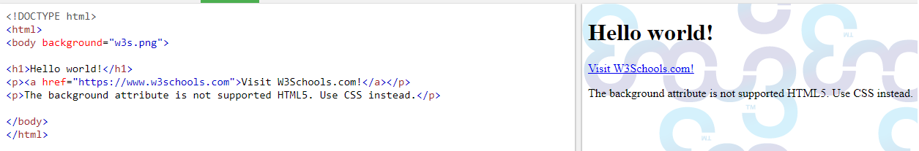
Demo of background image

